Slide 1





Automate resource state with AWS State Manager
November 2023

Slide 2
What is AWS State Manager?
Part of AWS Systems Manager
Automates the process of keeping managed nodes in a defined state
Installing antivirus software on managed nodes
Joining managed nodes to an Active Directory domain
Starting of Stopping RDS instances
and more…
Multiple targeting options
Flexible scheduling options
Available at no additional cost
Notes:
AWS State Manager is a capability of AWS Systems Manager that provides a secure and scalable configuration management to automates the process of keeping managed nodes or AWS resources in a defined state
By using pre-configured SSM Documents, State Manager can manage nodes and other AWS resources such as
Bootstrapping nodes with specific start-up software
Joining nodes to an Active Directory domain
Starting or stopping RDS instances (that we will see later)
AWS State Manager targets managed nodes, including on-prem instances, as well other AWS resources
Applying state changes can be scheduled immediately or on a set frequency
AWS State Manager is a service included at no additional cost

Slide 3











Getting Started
Managed nodes and AWS resources
AWS-InstallApplication
AWS-ApplyPatchBaseline
Association
AWS State Manager
AWS-CreatedDynamoDbBackup
Notes:
To get started with AWS State Manager, first determine the state you want to apply to your AWS resources
> This dictates which SSM Document to use when creating a State Manager association
> AWS managed SSM Documents can be used or a customer managed SSM Document can be created using tools like PowerShell or Python
> Next create a State Manager association which specifies the configuration to be assigned to the managed nodes or AWS resources
> It contains parameters for the SSM Document,
> Targets for the associations – which can be tags, instance IDs, AWS Resource Groups, or all managed nodes in a Region and Account,
> As well as the schedule specifying when or how often to apply the state – this can be a cron or rate expression

Slide 4
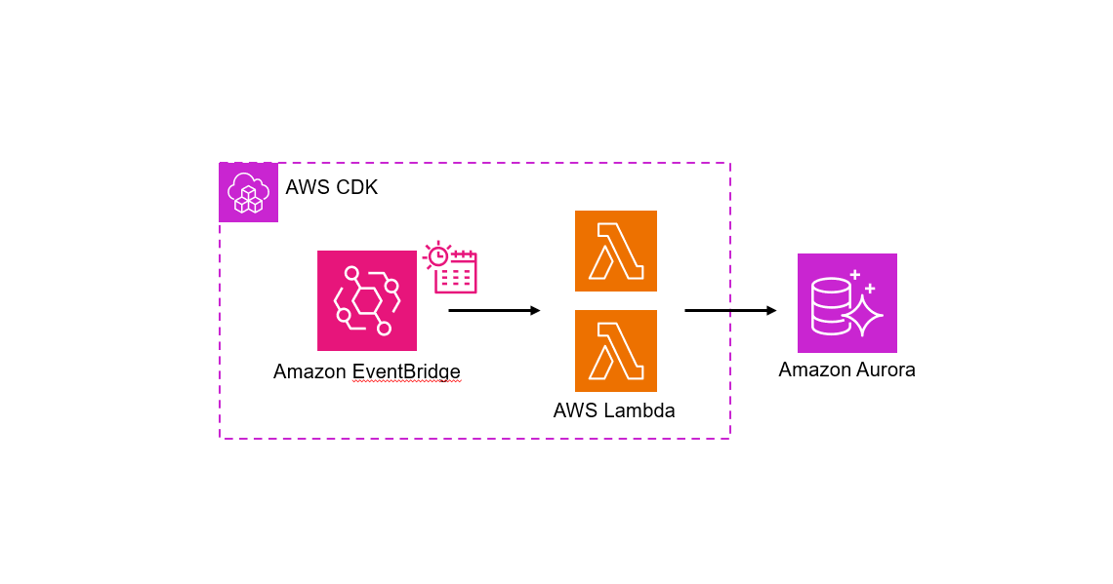
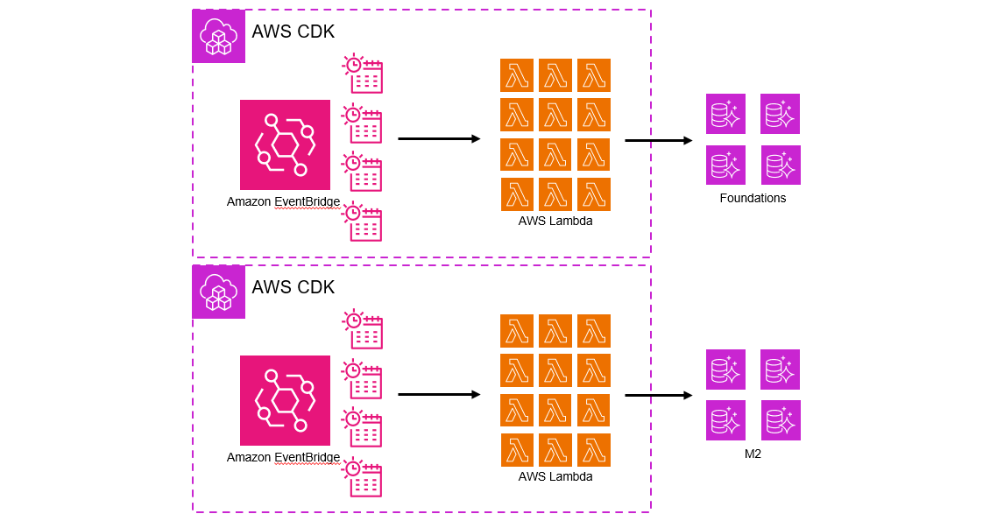

Existing Solution
56 Lambda Functions/28 EventBridge Rules
Reserved Concurrency Limit
Lambda execution costs
Per-app configuration
Automate the Start/Stop of Aurora Clusters
Notes:
> The existing solution to automate the starting and stopping of Aurora Clusters consists of an EventBridge scheduler rule that invokes a multiple Start/Stop Lambda functions containing custom code to Start/Stop an Aurora cluster
> When we add additional applications, we duplicate this infrastructure
> And with a targer eam of developers, this quickly grows to a sizable number of resources that begins to impact operational reliability
> Currently this setup consist of 56 Lambda functions, which now
Upon invocation eats away at our Regional Lambda Reserved Concurrency limit
Incurs unnecessary cost for Lambda execution
Requires managing of the IaC code
Needs to be re-created for each application using an Aurora or RDS cluster

Slide 5





Architecture
AWS Systems Manager
AWS State Manager
Amazon EventBridge
Amazon SNS
Association
StartStopAuroraClusterWithTags
Amazon Aurora
Notes:
> As we have seen, to achieve this in AWS State manager we will need to create our Association
> The Association executes a modified version of the AWS Managed SSM Automation Document, AWS-StartStopAuroraCluster, by adding support to control it using Tags
> Using a cron expression to trigger the automation process, we are able to use the updated SSM Automation Document to Start and Stop our Aurora clusters
> With built-in integration to Amazon EventBridge, we are optionally also able to > subscribe an email subscription to an SNS Topic to receive notifications on this state change
With this design we are able to leverage the built-in capabilities of AWS State Manage to automate a start/stop process to manage our Aurora cluster resources effectively

Slide 6



Demo Time
Start and Stop

Slide 7

Caveats
Limited cron expressions supported
https://docs.aws.amazon.com/systems-manager/latest/userguide/reference-cron-and-rate-expressions.html#reference-cron-and-rate-expressions-association
AWS::SSM::Association only supports Rate Control executions
Notes:
It wouldn’t be an AWS managed service without some roadblocks
Firstly, the support for rich cron expressions is very limited. This appears to be only for AWS State Manager associations and may change in the future
There is no support for multi day windows, only one or all
The CloudFormation API also only supports Rate Control executions for now
To get around this, after the AWS State Manager association is created I have to manually go in the console to change the execution type from Rate Control to Simple
This is a one-time only change so even though it is in AWS’ feature backlog it isn’t a huge deal yet

Slide 8
Where do we go from here?
Review and approve the following PR #<XXX>
Removes existing IaC code using Lambda function to Start/Stop clusters
Sets environment tag to “dev” for all non-staging/prod/security scan environments
Deploy AWS State Manager association
Re-deploy developer F1/M2 environments (without hotswap)
Get CloudOps to remove old Automation scripts (that don’t work)
Notes:
To get this released in our environments, I have PR for you to review
Removes existing Lambda function implementation
Changes the tags for the environment key for all developer environments to dev, the env key still remains as the developer GitHub username
Then we need to deploy the AWS State Manager association
Once each developer re-deploys their F1/M2 developer environments without hotswap it will be all setup
Remove the initial CloudOps implementation with SSM Automation scripts (which don’t work anyways)

Slide 9


Thank you!
Feedback
Questions

